Slide 1
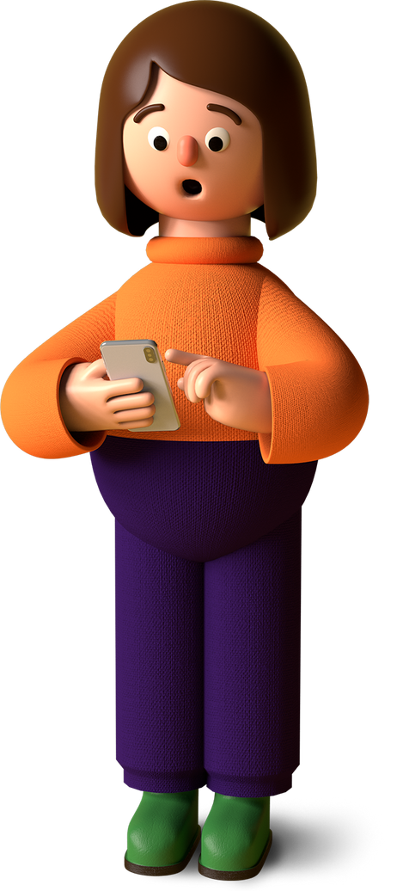
Gesture Based Controller Glove

Slide 2
mpu6050
FLOW OF INSTRUCTION
Arduino
Python Script

Slide 3

INTRODUCTION
The Gesture-Based Controller Glove harnesses the power of Arduino Uno, a versatile microcontroller board, and the MPU6050, a 6-axis accelerometer and gyroscope module, to enable users to control digital devices using natural hand movements. This glove serves as a bridge between humans and machines, providing an intuitive and seamless means of communication.

Slide 4

The MPU6050 sensor, with its precise motion tracking capabilities, captures the orientation and acceleration of the hand in real-time. The Arduino Uno, acting as the brain of the system, processes this data and translates it into meaningful commands that can be understood by various devices. With this glove, users can interact with computers, virtual reality environments, robotic systems, and more, all through simple hand gestures.

Slide 5

AIM
To make Gesture based Controller glove uding Arduino and mpu6050 Bluetooth Module

Slide 6
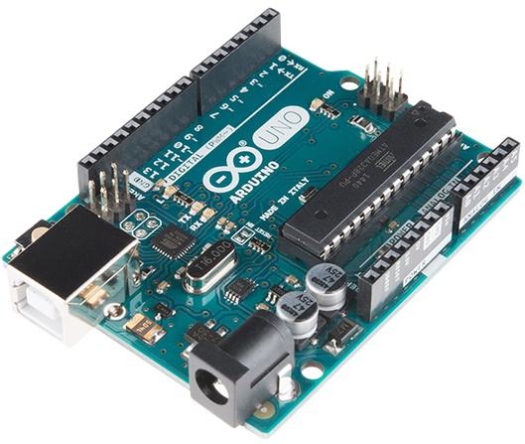

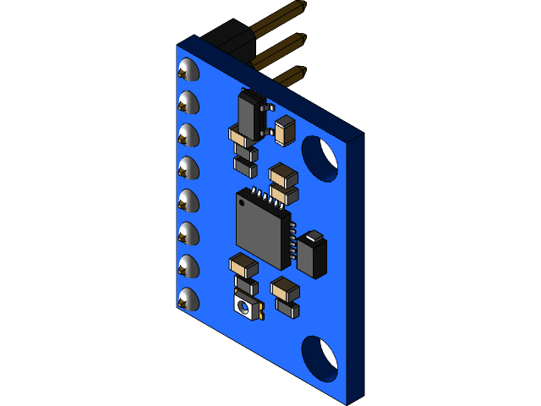
COMPONENTS REQUIRED
Arduino uno: Arduino UNO is a microcontroller board based on the ATmega328P. It has 14 digital input/output pins (of which 6 can be used as PWM outputs), 6 analog inputs
MPU6050: The MPU6050 consist of 3-axis Gyroscope with Micro Electro Mechanical System(MEMS) technology. It is used to detect rotational velocity along the X, Y, Z axes

Slide 7
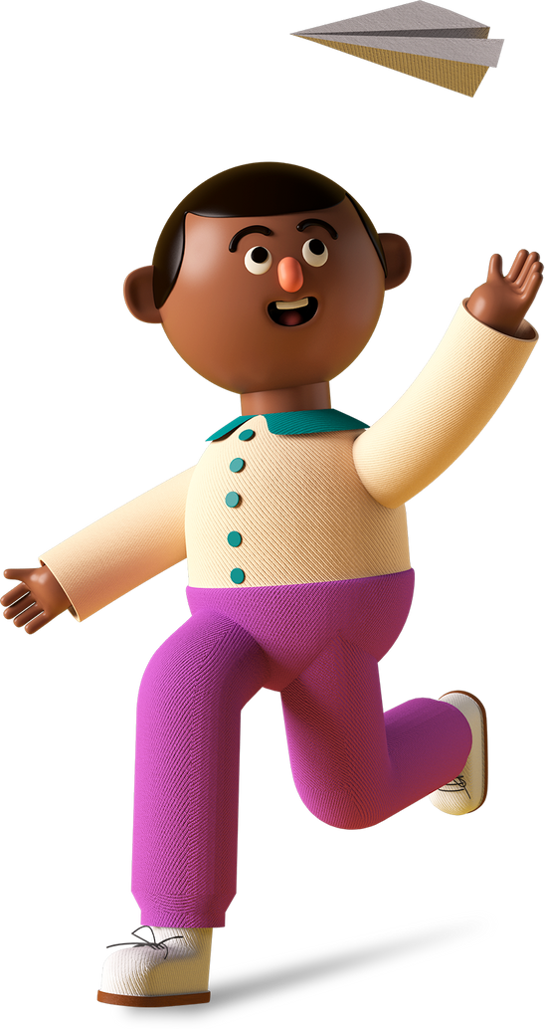
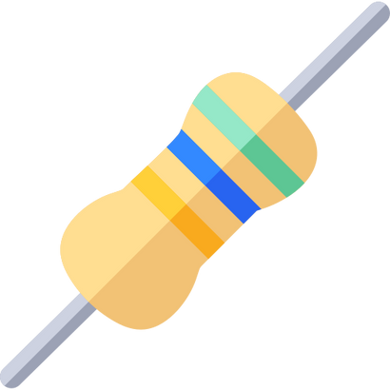
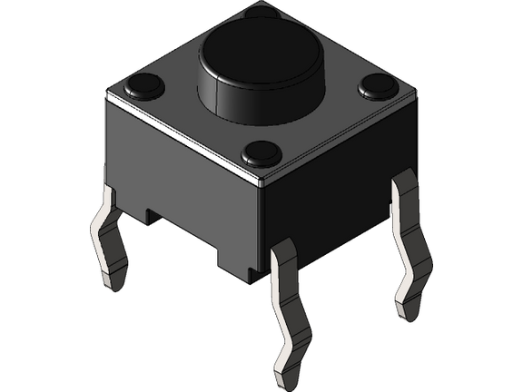
Resistor: A resistor is a passive two-terminal electrical component that implements electrical resistance as a circuit element
Push Buttons: Push Buttons are normally-open tactile switches. Push buttons allow us to power the circuit or make any particular connection only when we press the button.

Slide 8
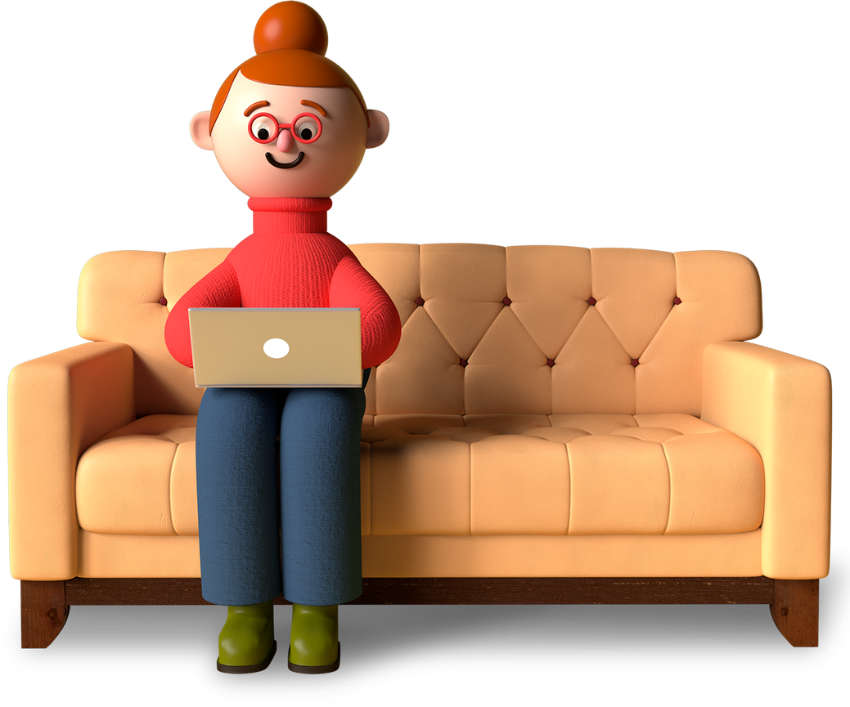
FEATURES
01
Gesture Recognition
02
Fully customizable
03
Arduino Uno Compatibility:
04
Precise Motion Tracking

Slide 9

FEATURES
05
Compatibility with Various Devices
06
Portability

Slide 10

CONSTRUCTION
The MPU6050 module Communicate to the Arduino Uno using jumper wires
The Arduino recognize the gesture using the input provided by the MPU6050 and decide which operation to Perform
The Python script reads from the Serial and then perform that specific operation that has been assigned to that gesture

Slide 11
import serial
import pynput
from pynput.mouse import Button
from pynput.keyboard import Key , Controller
import time
s = serial.Serial('COM7',9600)
keyboard = Controller()
mouse = pynput.mouse.Controller()
while True:
data = s.readline()
if(data.decode().strip()=="up"):
keyboard.press(Key.up)
time.sleep(0.4)
keyboard.release(Key.up)
print("up")
if(data.decode().strip()=="down"):
keyboard.press(Key.down)
time.sleep(0.4)
keyboard.release(Key.down)
print("down")
if(data.decode().strip()=="left"):
keyboard.press(Key.left)
time.sleep(0.4)
keyboard.release(Key.left)
print("left")
if(data.decode().strip()=="right"):
keyboard.press(Key.right)
time.sleep(0.4)
keyboard.release(Key.right)
print("right")
if(data.decode().strip()=="leftClick"):
mouse.press(Button.left)
time.sleep(1)
mouse.release(Button.left)
print("leftClick")
if(data.decode().strip()=="rightClick"):
mouse.press(Button.right)
time.sleep(1)
mouse.release(Button.right)
print("rightClick")
#include "Wire.h"
#include "I2Cdev.h"
#include "MPU6050.h"
const int buttonPin_right = 7;
const int buttonPin_left = 8;
int buttonState_right = 0;
int buttonState_left = 0;
MPU6050 mpu;
int16_t ax, ay, az;
int16_t gx, gy, gz;
struct MyData {
byte X;
byte Y;
};
MyData data;
void setup()
{
Serial.begin(9600);
Wire.begin();
mpu.initialize();
pinMode(buttonPin_right, INPUT);
pinMode(buttonPin_left, INPUT);
}
void loop()
{
delay(500);
buttonState_right = digitalRead(buttonPin_right);
buttonState_left = digitalRead(buttonPin_left);
if(buttonState_left == 1){
Serial.println("leftClick");
}
if(buttonState_right == 1){
Serial.println("rightClick");
}
mpu.getMotion6(&ax, &ay, &az, &gx, &gy, &gz);
data.X = map(ax, -17000, 17000, 0, 255 );
data.Y = map(ay, -17000, 17000, 0, 255);
if (data.Y < 80) {
Serial.println("up");
}
if (data.Y > 145) {
Serial.println("down");
}
if (data.X > 155) {
Serial.println("left");
}
if (data.X < 80) {
Serial.println("right");
}
}
CODE

Slide 12
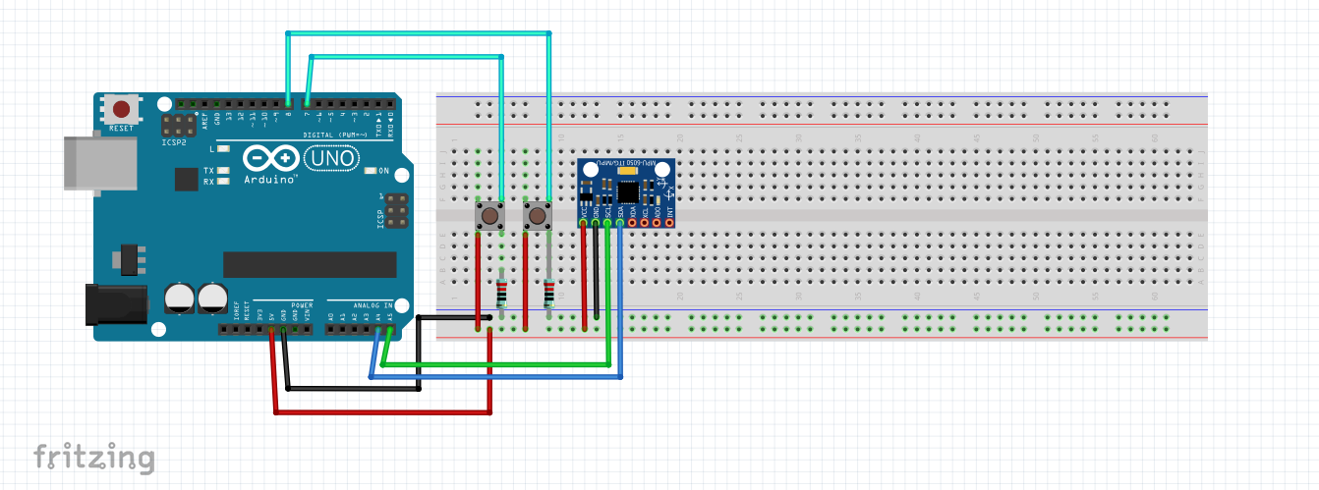

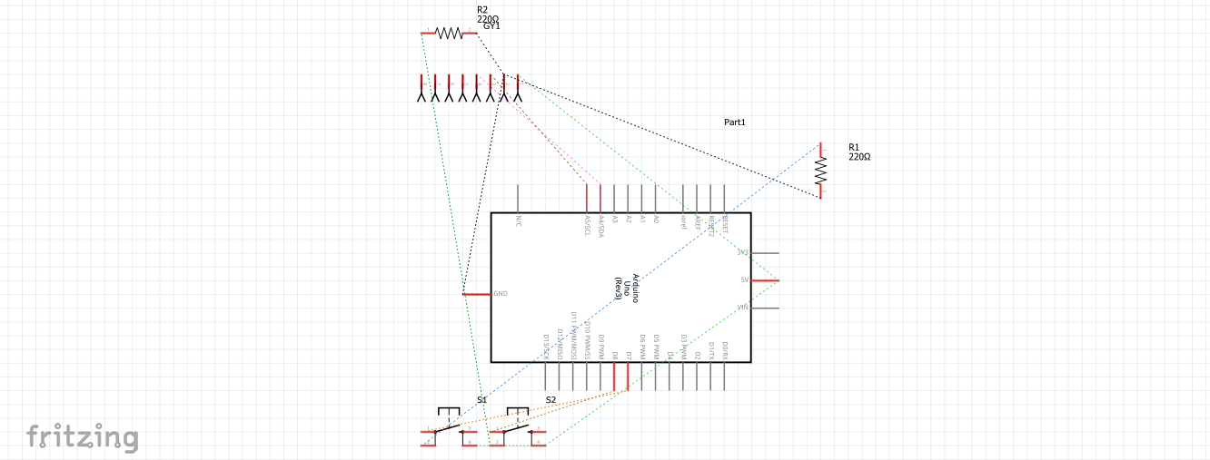
Circuit Diagram

Slide 13
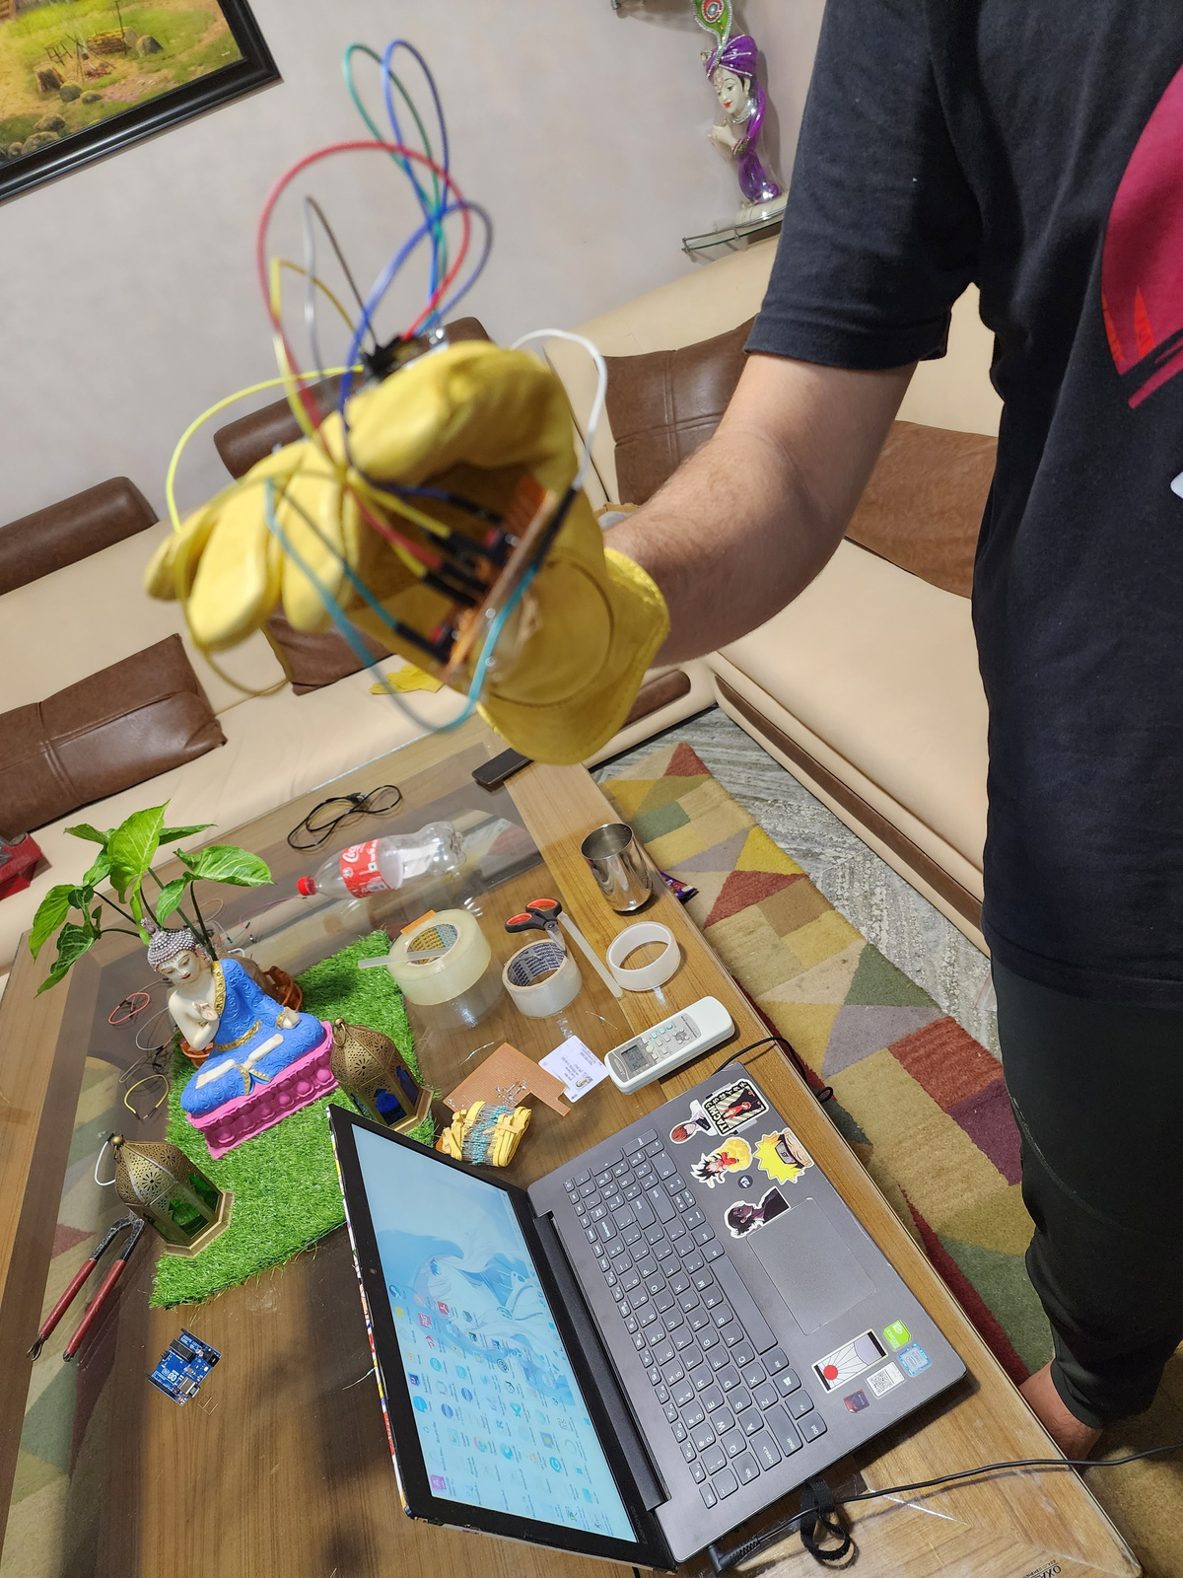
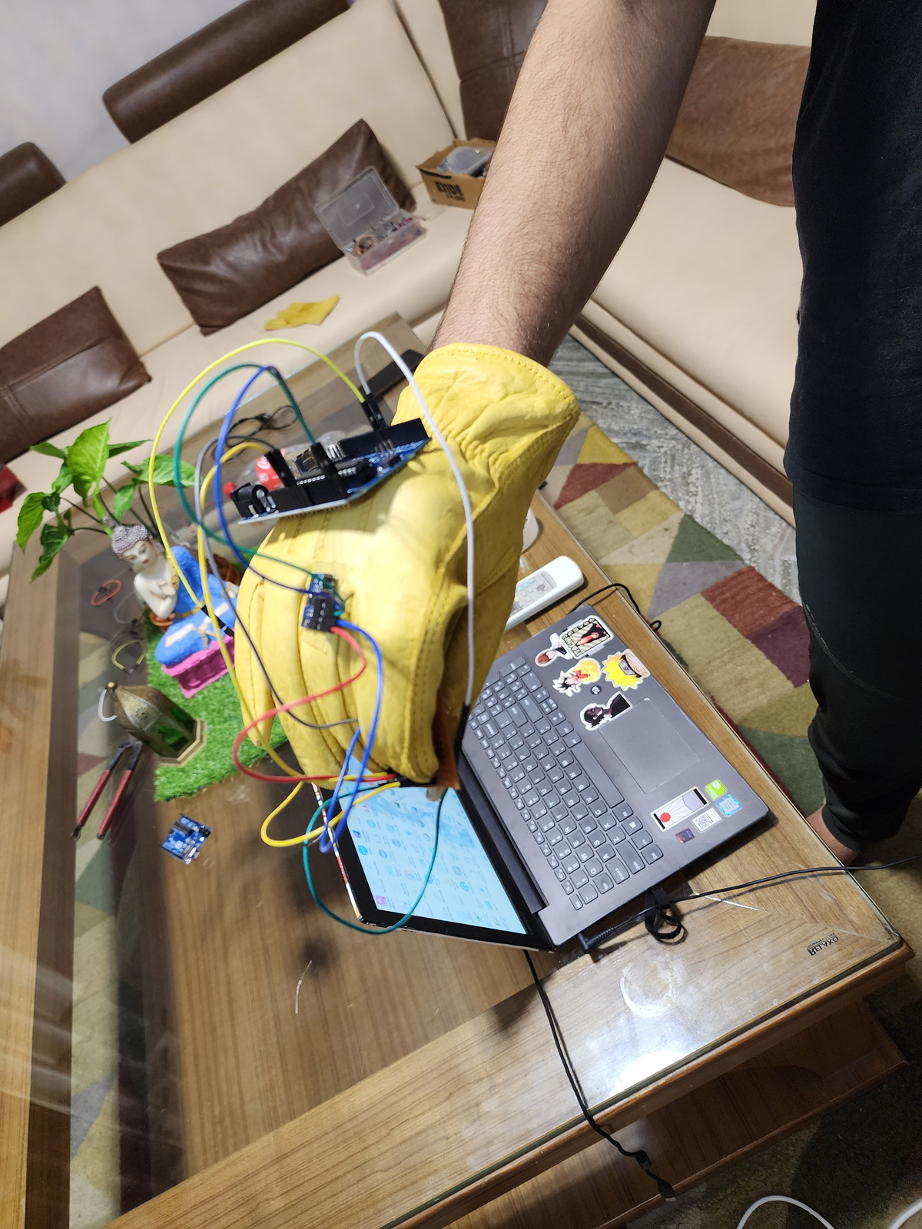
REAL MODEL

Slide 14
Future Scope
Making the circuit compact
making it wireless
adding more modules
making it more versatile

Slide 15



THANK YOU
Created and conceptualized by:
Kunal Chauhan
Repo link

